Slide 1
Daily Work Management
A digital tool to make shopfloor performance visible, every single day.

Slide 2

Why Daily Work Management?
WHAT CHANGES WITH DWM
WHY WE ARE DOING THIS
CHALLENGE TODAY
WITH DWM
Every shift, the shopfloor generates valuable performance data — production, downtime, quality, safety and delivery. Today much of it lives in separate, manual formats, so real-time performance is hard to see across the layers of management.
✕
No shopfloor visibility
→
✓
A single real-time dashboard
✕
Manual paper & spreadsheets
→
✓
Structured digital capture
The Result: Bring this data together to spot issues sooner, decide faster, and lift profitability.
✕
Reactive firefighting
→
✓
Proactive, KPI-led management
Objective — Give every role clear visibility of shopfloor performance, problems and action status, in real time from Operator to Plant Head.
✕
Weekly / monthly reports
→
✓
Faster, data-driven decisions
2
Redefining Quality

Slide 3


What is Daily Work Management?
DWM is the art of executing daily work in a consistent, systematic and efficient manner. It is the foundation for organizational success — maintenance of standards, plus continuous improvement (Kaizen).
Planning
Organizing
Monitoring
Set clear objectives, define tasks and timelines, and allocate resources effectively.
Standardize procedures, define roles and responsibilities, and open clear lines of communication.
Monitor and measure performance, spot deviations from standard, and act to correct them.
How it works
PROVEN VALUE OF LEAN DAILY MANAGEMENT
Capture shopfloor data
›
Monitor KPIs in real time
›
Escalate issues automatically
›
Drive continuous improvement
~15% operational efficiency
~10% improvement in profit margin
3
Redefining Quality

Slide 4
Role-Wise Data Flow, Data Entry and Reports
Four user levels, the steps each performs, and how data moves between them
Role
Data Flow
Data Entry
Reports
IFQM Platform User
Admin overview only
Onboard Tenant
Create Users
Assign Roles
Plants · Users · Roles
tenant isolation
No visibility of plant production data
Level 1 · Platform
Plant Head / Plant Admin
Configuration · Shifts
All plant dashboards
Set Thresholds
Define Shifts
Plant Dashboards
Users · Roles
PDF export
Level 2 · Plant
Setup flows down
Supervisor
Assets · APQ Approve
Shift & machine OEE
Manage Assets
Approve APQ
OEE Computed
Live data flows up
PDF export
Level 3 · Shop floor
Safety · Delivery · OPL
Operator
APQ Create & Submit
Own tasks only
Login (OTP)
Enter APQ
Submit
OPL Update
No export
Level 4 · Machine
5
Setup and configuration flow downward · operational data and KPIs flow upward, stopping at the plant boundary — Platform Admin never sees production data.
Redefining Quality

Slide 5
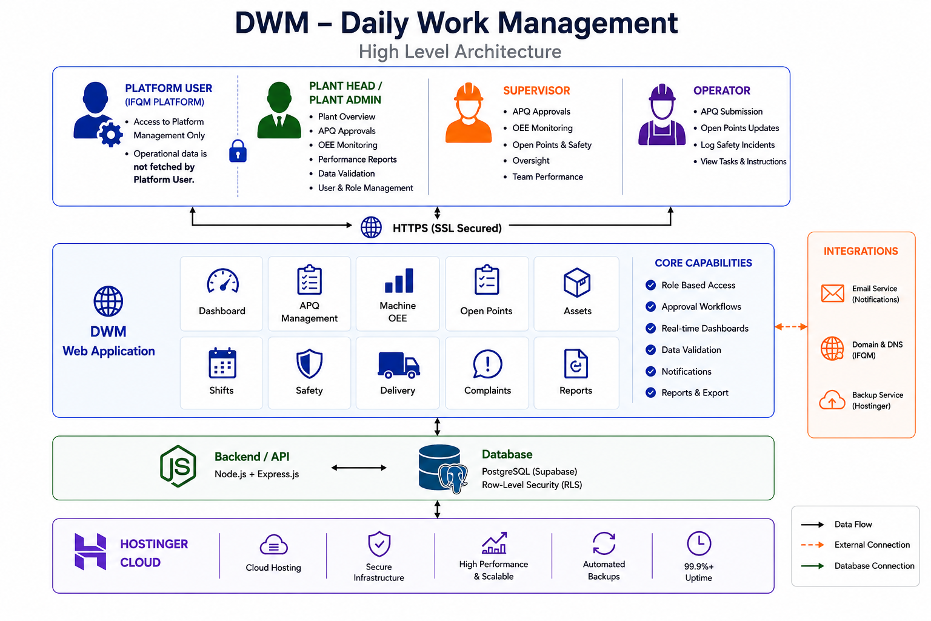
High-Level System Architecture
Frontend
React — responsive, role-based UI
Backend / API
Node.js + Express REST server
Database
PostgreSQL (Supabase) with RLS
Hosting
Hostinger Cloud · 99.9%+ uptime
Security
HTTPS/SSL · JWT · multi-tenant
6
Redefining Quality

Slide 6
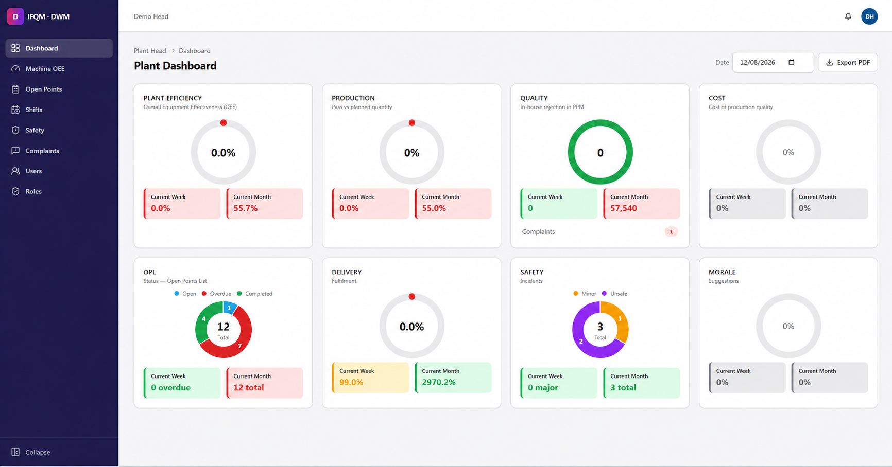
Plant Head Dashboard
The Plant Head sees the whole plant on one screen: OEE, production, quality, cost, open points, delivery, safety and morale.
AT A GLANCE
Real-time KPIs
Open Points
Safety & Delivery
Week vs Month
7
Redefining Quality

Slide 7
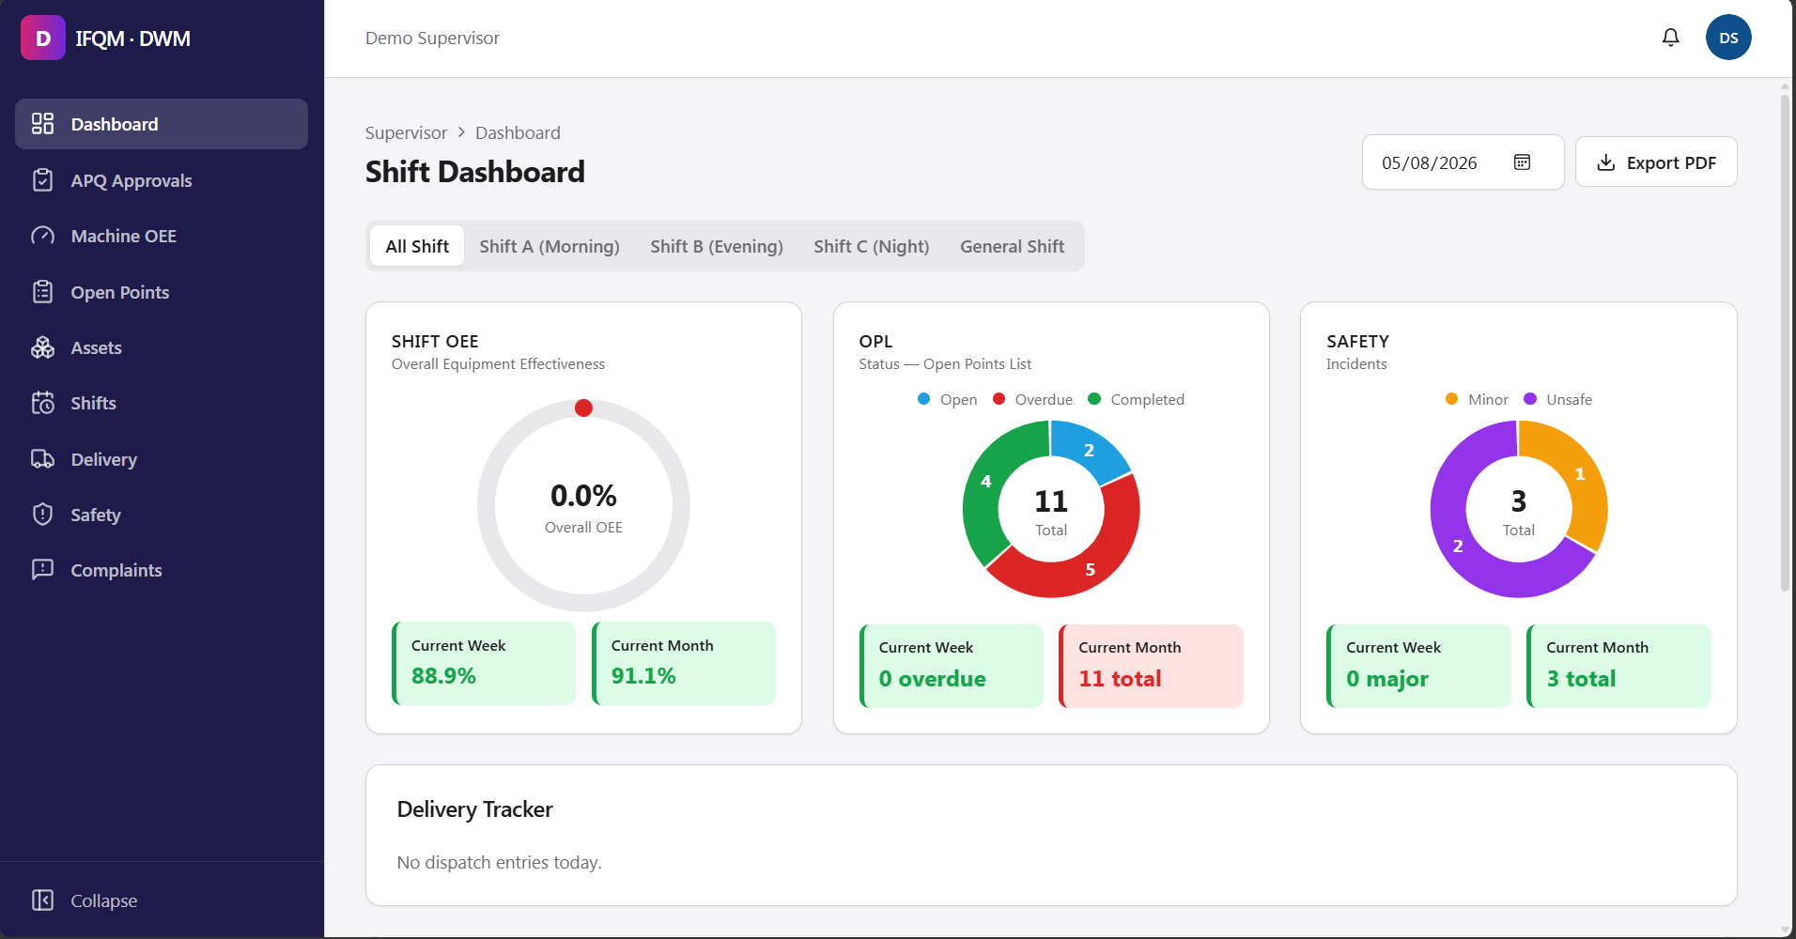
Supervisor Dashboard
The Supervisor monitors the shift and keeps the day on track.
WHAT THIS ROLE DOES
Shift OEE monitoring
Open Points management
APQ approvals
Safety & delivery oversight
8
Redefining Quality

Slide 8
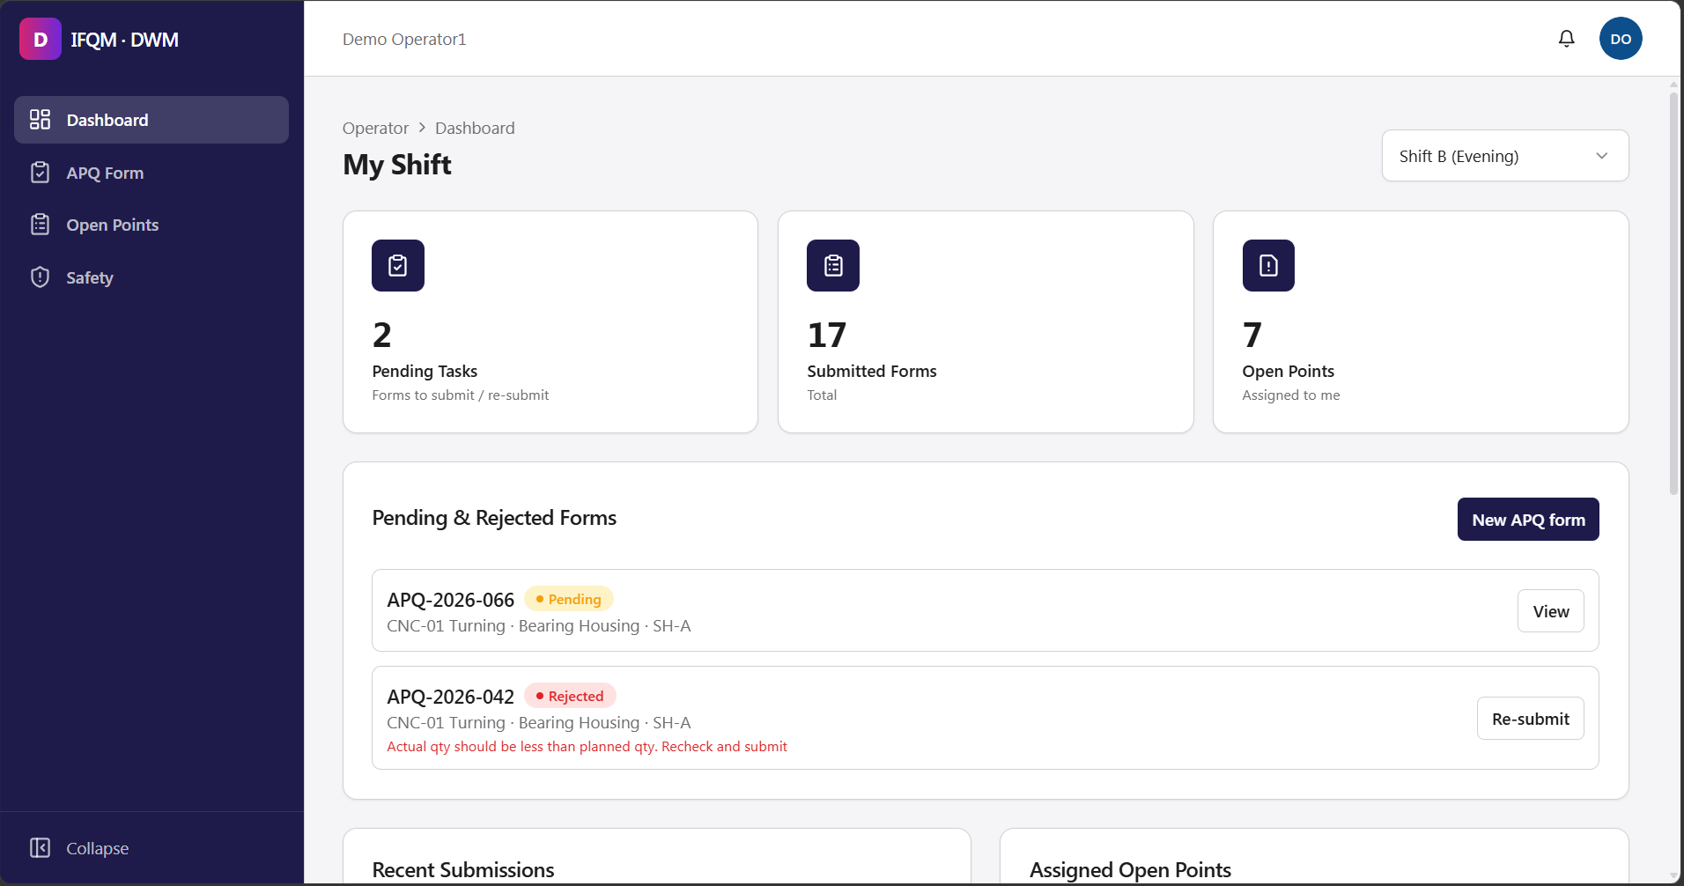
Operator Dashboard
A simple, mobile-friendly view — the shift is detected automatically at login.
WHAT THIS ROLE DOES
Submit APQ forms
Track pending / rejected
Update open points
Log safety incidents
9
Redefining Quality

Slide 9

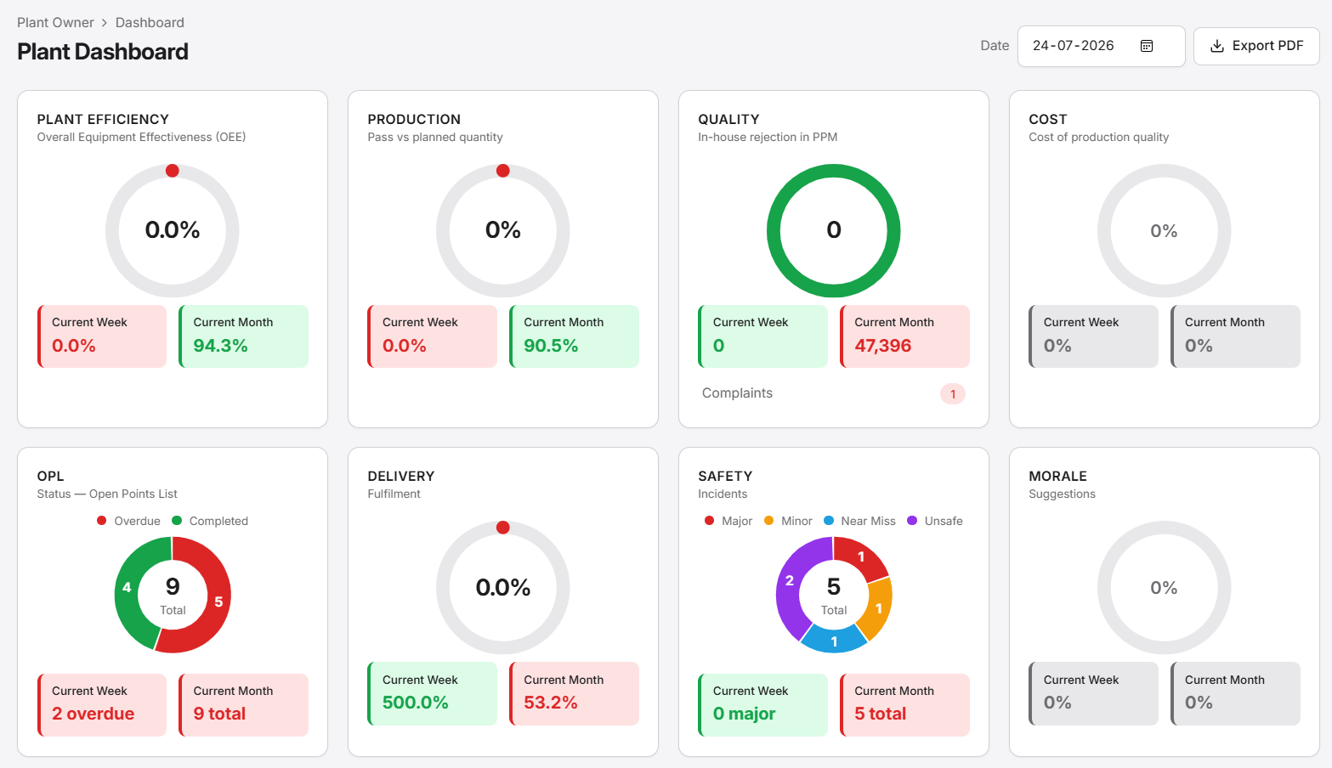
Live Plant Dashboard
One screen shows the whole plant: OEE, production, quality, cost, open points, delivery, safety and morale — updated daily.
AT A GLANCE
Real-time KPIs
OEE · Production · Quality · Cost
Open Points List
Overdue vs completed, at a glance
Safety & Delivery
Incidents and fulfilment tracked
Week vs Month
Trends side-by-side per metric
Plant Owner → Dashboard · role-based view · Export to PDF
7
Redefining Quality

